Slide 1

DIVERSITY IN THE SILICON VALLEY.
How diverse is Silicon Valley in reality
DATA REVEALS

Slide 2
THE QUESTION: IS SILICON VALLEY DIVERSE?
DIVERSITY is about VARIETY.
Diversity inadvertently carries the question of equality. Variety based on gender and race for the case in hand.
Quantifying and visualizing to actually put this claim to the test.
Breaking down diversity in terms of race and gender.
A lot of the companies in the Silicon Valley claim that they are diverse and provide an equal opportunity
2

Slide 3
APPROACH
FOR ANALYSIS

Slide 4
DATA EXPLORATION
DISCOVERIES
ACTION
REASON
Loaded the CSV file into a data-frame using Python & Pandas.
There were 264 missing values for the gender data. These data points were “Overall totals” based on ever job category present in the data set and therefore had no gender.
Tableau was used for visualization primarily and aggregations.
Created Sets to filter and use only “male” and “female” data for majority of the visualizations.
Tableau would allow to create Interactive Dashboards seamlessly.
This would also inflate the values and repeat them therefore not provide a true representation.
Decided not delete the data as it would be useful for other visualizations.
4

Slide 5
DATA EXPLORATION
DISCOVERIES
ACTION
REASON
Each company had “Totals” and “previous totals” that captured the entire organization’s head count.
The “count” column data was not an integer as it had strings “na”, denoting a company’s record on “previous totals”.
Created a Set to filter out these options and used them to check hiring trends for the assumed previous year and year in question.
Converted the “count” to integer when loading the data on Tableau. Did not need to adjust for the “na” values as they were filtered out in the sets created for the job categories.
If the two were not filtered they would inflate the total values for each of the categorical data.
This would allow for aggregation and it is the only numeric data present.
5

Slide 6






THE DATA AT
A GLANCE
22 COMPANIES
Variety of industries with a tech focus
YEAR 2016
One distinct year in question
7 RACES
White, Asian, Black....
10 JOB CATEGORIES
A combination of broad and specific categories from executives to technicans and service workers
2 GENDERS
Male & female

Slide 7
WORKFLOW
Diversity
Focus on Overview
Focus on Company level
Focus on Job level
RACE
GENDER

Slide 8
FOCUS ON:
GENDER DIVERSITY
DISCOVER

Slide 9


OVERVIEW OF GENDER DIVERSITY IN SILICON VALLEY
3 in 10
Employees are Female
Implying women account only for a THIRD of the 350k employees in the silicon valley.

Slide 10
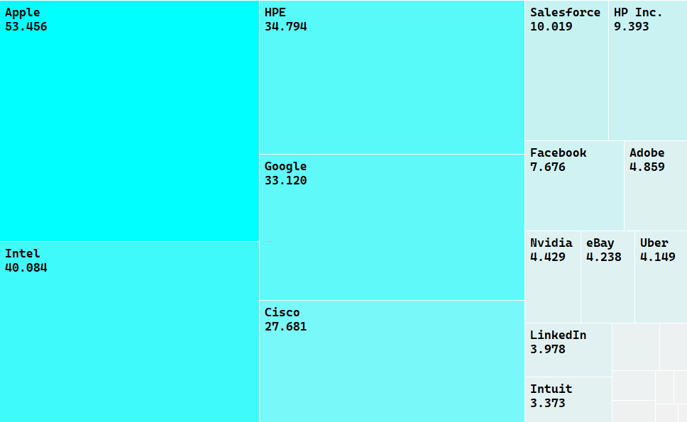
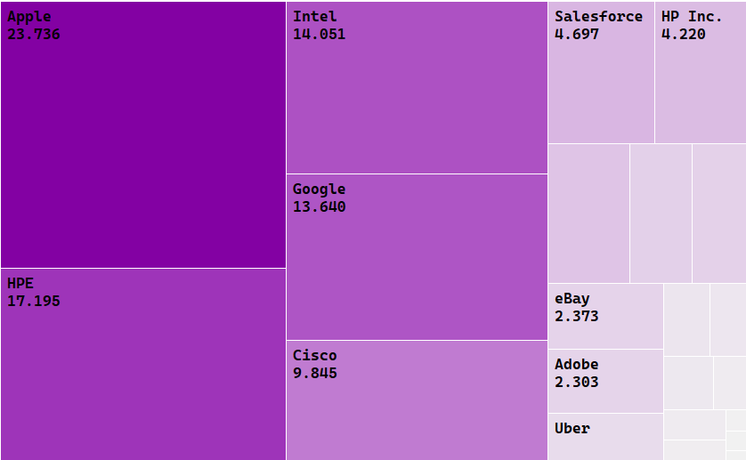
OVERVIEW AT A COMPANY LEVEL.
Focusing on sheer numbers would mean that the companies that have the largest workforce would also have more females working for them, despite the company structure.
Comparing companies would be difficult as they would be on different structures maturities and sizes
Male Female
Notes:
As you can see the biggest 5 in terms of workforce are Apple Intel HPE Google Cisco

Slide 11
OVERVIEW AT A COMPANY LEVEL.
Focusing on % would give a better picture as each company has different structures maturities and sizes
Companies who have a Female workforce > 40%
Employees
6655
1433
1917
5911
944
297
59,77%
57,50%
57,12%
57,06%
56,89%
50,17%
49,83%
42,88%
42,94%
43,11%
40,23%
42,50%
LinkedIn
Lyft
Airbnb
Intuit
Pinterest
23andMe
Male Female
Notes:
Interesting note here is that these companies actually did not represent the Big 5 so to say in the heatmap, another interesting point to note is that only 23andme has a female ceo

Slide 12
OVERVIEW AT THE JOB POSITIONS.
The companies have different structures based on the specific products and services they offer and therefore a closer insight at the following 3 job positions that would exist regardless of the product / service offered would make more comparable sense.
Job Category:
Executive/Senior Officials & Managers
First / Mid
Officials & Managers
Professionals
Across All
Companies:
22,75%
30,11%
30,11%
77,43%
69,89%
69,89%
Male Female
3 Most Diverse*
eBay
31,43%
eBay
38,42%
HP inc.
33,54%
Facebook
28,02%
Google
36,94%
HPE
33,04%
Uber
26,81%
Adobe
34,72%
Adobe
29,49%
3 Least Diverse*
Google
0,00%
Intel
22,80%
Apple
25,46%
Intel
0,00%
Cisco
22,80%
Google
23,85%
Nvidia
0,00%
Nvidia
20,25%
Nvidia
16,44%
* Companies > 4000 employees only
Notes:
Interesting note here is that these companies actually did not represent the Big 5 so to say in the heatmap, another interesting point to note is that only 23andme has a female ceo

Slide 13
FOCUS ON:
RACIAL DIVERSITY
DISCOVER

Slide 14
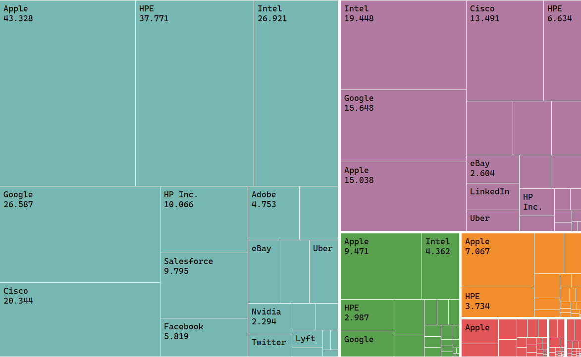
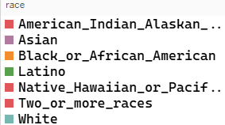
OVERVIEW OF RACE DIVERSITY IN SILICON VALLEY
From the overview it can be observed that there are a lot of White employees at the “Big 5 firms”*, followed by people who identify as Asians.
1,98%
27,09%
58,32%
5,02%
7,26%
* Big 5 comprise of: Google, Apple, Cisco, HPE & Intel
Notes:
As you can see the biggest 5 in terms of workforce are Apple Intel HPE Google Cisco

Slide 15
WHAT ABOUT AT A COMPANY LEVEL?
Excluding people who identify as White or Asian as they are the majority races present. It is evident that the other 5 groups are minorities and are under-represented.
34,44%
1%
3,46%
49,76%
11,34%
1%
Native Hawaiian/Pacific Islander
Latino
Black / African American
Two or More Races
American Indian / Alaskan
THE “Big 5*” ACCOUNT FOR:
75,32% of the entire African American workforce.
82.25% of the entire Latino workforce.
HPE had a restructuring which led to a lot of dismissals however the composition on a racial point of view had not changed much
* Big 5 comprise of: Google, Apple, Cisco, HPE & Intel
Notes:
Interesting note here is that these companies actually did not represent the Big 5 so to say in the heatmap, another interesting point to note is that only 23andme has a female ceo

Slide 16
WHAT ABOUT THE JOB PERSPECTIVE?
The companies have different structures based on the specific product and service they offer and therefore a closer insight at the 3 Job categories that would exist regardless of the product / service offered.
Job Category:
Executive/Senior Officials & Managers
First / Mid
Officials & Managers
Professionals
74,10%
77,43%
69,89%
69,89%
Across All Companies:
24,10%
20,08%
24,10%
53,33%
36,44%
2,86%
5,17%
5,15%
White
Asian
Latino
African American
Minorities *
The Minorities especially the Latino and African American Races are the 2nd and 3rd largest workforce groups after White people in the other categories of jobs such as Sales workers, Technicians, Operatives.
* Companies > 4000 employees only
Notes:
Interesting note here is that these companies actually did not represent the Big 5 so to say in the heatmap, another interesting point to note is that only 23andme has a female ceo

Slide 17
FOCUS ON:
COMBINED INSIGHTS.

Slide 18
COMBINING GENDER AND RACE
DISCOVERIES
Latino Males are under-represented relative to Latino Females, on average across all 3 key positions by 3% on average.
African American women hold approximately 3% of the top level jobs as opposed to men who hold only 1% on average.
On average people of two or more races hold just 1% of the top level positions whilst the other remaining races have almost negligible presence.
18

Slide 19
FOCUS ON:
POTENTIAL AVENUES TO FOLLOW.
19

Slide 20
ADDITIONAL INSIGHTS
DISCOVERIES
ACTION
REASON
Each of the job categories is a combination of various positions.
More data over the a period of time
This will allow for a more detailed analysis and visualization to aid in answering the objective at hand.
This would allow for a better trend analysis to discover whether the beahviour of companies is changing in regards to hiring people of different gender and race.
It would be a good strategy to obtain data on a more segregated level.
20

